Slide 1


Literature Review Presentation 2
Batch No: 20CSEA003
Team members
V.Ganga Bhavani : 20K61A05G9
S.Venkateswara Rao : 20K61A05F3
K.Manasa Lakshmi : 20K61A0571
Guide
Dr. A V S Siva Rama Rao
Associate Professor,CSE.
Department of Computer Science and Engineering

Slide 2
LAW-U: Legal Guidance Through Artificial Intelligence Chatbot for Sexual Violence Victims and Survivors
Title:
Authors: Vorada Socatiyanurak,Nittayapa Klangpornkun, Adirek Munthuli
Publisher : IEEE
Published Year : 2021

Slide 3
Introduction
Conservatism in Thai culture
Victim-blaming
Patriarchy
Power-relation dynamic
The chatbot's ability to access and process information from Supreme Court decisions is a valuable resource,
It focus on providing unconditional support is essential for survivors who may be feeling isolated and alone.

Slide 4
Abstract
LAW-U is an AI chatbot that can provide legal guidance to survivors of sexual violence in Thailand.
LAW-U was trained on a dataset of 182 Thai Supreme Court cases of sexual violence.
LAW-U can recommend the most relevant Supreme Court decisions to survivors of sexual violence based on their situation.
LAW-U can also provide information about sexual violence laws and resources in Thailand.

Slide 5
Proposed Algorithm
NLP is used in LAW-U to understand the user's input and generate responses that are relevant and helpful.
Dialogflow is used in LAW-U to create the conversation flow and to manage the user's input and output.
The Naive Bayes classifier is used in LAW-U to classify the user's input into different categories, such as "sexual harassment", "sexual assault", or "rape".

Slide 6
Novelty of the paper
The use of a combination of similarity scores, common keywords, and synonyms to find the most relevant Supreme Court cases.
The use of a stratified 5-fold cross-validation to evaluate the performance of the model.
The use of a hold-out testing dataset to evaluate the performance of the model in a real-world setting.
The identification of two Supreme Court cases that were not ranked in TOP-1 or TOP-3, which suggests that the model may be better at finding cases that are similar in context, even if they do not share the same keywords

Slide 7
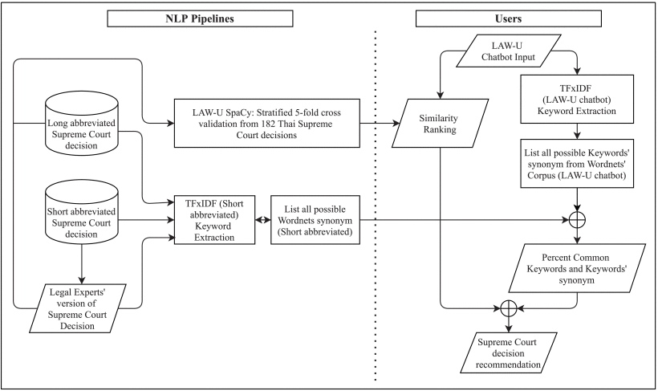
Block Diagram

Slide 8
Future work
Expanding the dataset to include more Supreme Court cases and real-life test subjects
Expanding the chatbot to answer in English. This will make the chatbot more accessible to a wider audience.
Overall, the future work of LAW-U chatbot is to improve its accuracy, reliability, and accessibility so that it can be a more effective tool for survivors of sexual violence.

Slide 9
Entertainment Chatbot for the Digital Inclusion of Elderly People Without Abstraction Capabilities
Title:
Authors : Silvia García-Méndez, Francisco De Arriba-Pérez, JOSé A. Regueiro-Janeiro
Publisher : IEEE
Published Year : 2021

Slide 10
Introduction
Discusses the challenges of designing a chatbot that is user-friendly and engaging for the elderly.
Paper proposes a solution that combines a familiar media channel (radio) with voice dialogues.
Reports on experimental tests with real users, which showed that the chatbot was effective in helping users access digital content.
Suggests that chatbots can be used to provide companionship and social interaction for elderly people.

Slide 11
Abstract
The EBER chatbot is designed to reduce the digital divide for elderly people by combining a familiar media channel (radio) with voice dialogues.
The chatbot reads news in the background and adapts its responses to the user's mood.
The chatbot allows users to access digital content of interest by combining words extracted from user answers to chatbot questions with keywords extracted from the news items.
The chatbot was evaluated in real-world experiments with elderly people and was found to be effective in helping them access digital content and improve their information search capabilities.

Slide 12
Proposed Algorithm
AIML: This is a markup language that is used to create chatbots. It allows you to define the chatbot's personality, knowledge base
NLG: This is a natural language generation algorithm that is used to create natural-sounding text.
SA: This is a sentiment analysis algorithm that is used to classify text into positive, negative, or neutral.

Slide 13
Novelty of the paper
It is one of the first studies to investigate the use of chatbots to improve the information abstraction capabilities of elderly people.
EBER was able to improve the ability of elderly people to describe the content of the news.
The findings of this study have the potential to improve the lives of elderly people

Slide 14
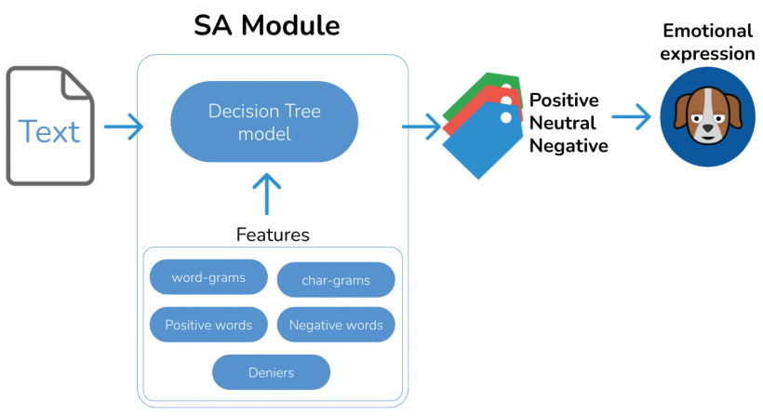
Block Diagram

Slide 15
Future work
Improve turn detection to avoid speech interruptions.
Add advanced personalization features with better directed dialogue stages.
Experimental assessment of loneliness.
Study how the quality of users’ responses evolves in time.
Study the effect of other forms of language semantics such as sarcasm.

Slide 16
AIDA-Bot: A Conversational Agent to Explore Scholarly Knowledge Graphs
Title:
Authors : Antonello Meloni,Simone Angioni,Angelo Salatino,Francesco Osborne
Publisher : IEEE
Published Year : 2023

Slide 17
Introduction
Scholarly knowledge graphs (SKGs) are large-scale repositories of information about scholarly publications, authors, and other entities.
Conversational agents are computer programs that can interact with users in a natural language way.
AIDA-Bot is a conversational agent that can interact with SKGs. It is based on a three-step process: parsing, query building, and answer generation.
AIDA-Bot has been implemented in four different ways: as an Alexa skill, a web application, a Telegram bot, and an NAO humanoid robot.

Slide 18
Abstract
AIDA-Bot, a conversational agent that can interact with scholarly knowledge graphs.
AIDA-Bot has been implemented in four different ways: as an Alexa skill, a web application, a Telegram bot, and an NAO humanoid robot.
We have evaluated AIDA-Bot on a variety of tasks, including counting the number of papers on a given topic, listing the top-k papers on a given topic, and comparing two authors. The results show that AIDA-Bot is able to perform these tasks accurately and efficiently.
AIDA-Bot is a promising new approach for interacting with scholarly knowledge graphs. The architecture proposed by the authors is versatile and can be implemented in a variety of ways.

Slide 19
Proposed Algorithm
The algorithm proposed in the paper is called the Natural Language Query Processing (NLQP) algorithm. The NLQP algorithm is a three-step process that is used to interact with knowledge graphs. The three steps are:
Parsing , Query building, Answer generation
NLQP algorithm also uses a number of other techniques to improve the accuracy and performance of the system. These techniques include:
Fuzzy matching, Entity recognition, Query optimization

Slide 20
Novelty of the paper
This is a novel approach to interacting with knowledge graphs, as it allows users to interact with the knowledge graph in a natural language way.
This demonstrates the versatility of the architecture, as it can be implemented in a variety of different ways.
The paper evaluates the performance of the architecture on a variety of different tasks.
This shows that the architecture is effective in a variety of different settings.

Slide 21
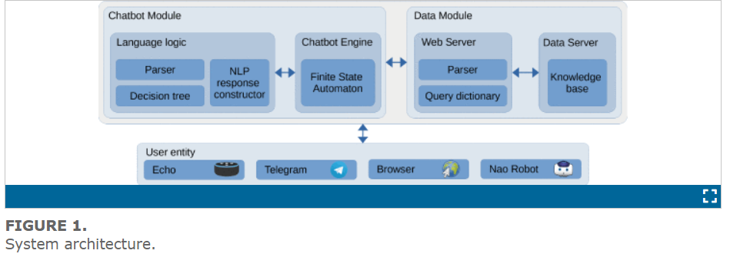
Block Diagram
.

Slide 22
Future work
Improving the accuracy and completeness of knowledge graphs, which are essential for chatbots to provide accurate and relevant information.
Developing more advanced natural language processing (NLP) techniques to enable chatbots to understand and respond to more complex queries.
Enhancing the context awareness of chatbots, which would enable them to provide more personalized and relevant responses to users.
Exploring the potential of integrating chatbots with other technologies, such as machine learning and data analytics, to enable more advanced functionalities and insights.

Slide 23
Experimentation for Chatbot Usability Evaluation: A Secondary Study
Title:
Authors : RANCI REN1 , MIREYA ZAPATA , JOHN W. CASTRO, OSCAR DIESTE AND SILVIA T. ACUÑA
Publisher : IEEE
Published Year : 2022

Slide 24
Introduction
Introduces chatbots as domain-specific text-based software that aid users in specific services.
Traces the origin of chatbots from Joseph Weizenbaum's ELIZA in the 1960s to their recent advancements driven by deep learning and natural language processing.
Highlights the need for systematic mapping study to analyze the current state of chatbot usability experimentation

Slide 25
Abstract
Rising interest in chatbot development and usability evaluation.
Systematic mapping study analyzed 700 sources, found 28 primary studies.
Explored research questions, characteristics, and metrics for chatbot usability.
Within-subjects design commonly used in experiments.
Limited availability of raw data suggests room for improvement.

Slide 26
Proposed Algorithm
GLM includes ANOVA and regression methods, ensuring the best linear fit to the data.
Linear regression, logistic regression, and mixed effect models used.
ANOVA and MANOVA applied to analyze variations in data.
Regression techniques used to examine relationships and dependencies.

Slide 27
Novelty of the paper
Paper merges HCI and SE viewpoints for novel chatbot usability evaluation.
Analyzes chatbot usability studies, highlighting research goals and usability aspects.
Common techniques like questionnaires, interviews, and metrics like Likert scale are used.
Identifies challenges, recommends larger sample sizes, and better experimental designs.
Chatbots find roles in healthcare, e-commerce, collaboration, and recommendations

Slide 28
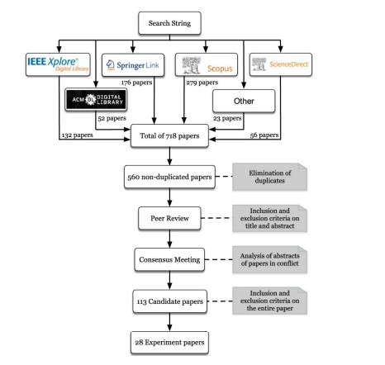
Block Diagram

Slide 29
Future work
Investigate the application of more advanced statistical methods, such as machine learning techniques, to analyze chatbot usability data.
Explore predictive modeling to anticipate user satisfaction and usability based on specific user characteristics and interaction patterns.
Combine quantitative usability metrics with qualitative insights to gain a more comprehensive understanding of user experiences.

Slide 30
Paper Number | Algorithm Used | Proposed Work | What output? | Future Work
1 | NLP, Dialog flow, Naive Bayes classifier | Research conducted to develop LAW-U | Developed an AI chatbot that can provide legal guidance | Expanding the chatbot to answer in English
2 | AIML, NLG, SA | To make chatbots more human-like. | Develop an intelligent chatbot to engage elderly people | Adding personalization features
3 | NLQP | AIDA-Bot, that can interact with scholarly knowledge graphs. | improving accuracy and enhancing the context awareness of chatbots | AIDA BOT gives answers through knowledge graphs
4 | Linear regression and Logistic regression | Making chatbots in domain-specific text-based for specific users | Usage of chatbots in various fields like healthcare,e-commerce | To enhance the usability of chatbot using more advanced statistical methods

Slide 31
THANK YOU

